Slide 1
Campus Shuttle ETA Project
Kyle Andrews (Back-up Lead)
Syed Hyder
Matthew Jackovich
Mohammed Kassem (Lead)

Slide 2
Development plan
Devplan 1.1----1.4
1.1: Project Overview
1.2: Project Purpose, Scope, Objectives,
1.3: Team Organization (roles and responsibilities)
1.4: Problem Resolution Policies

Slide 3
1.1: Project Overview
Client: Digital Communications, Wayne State University
Wayne State University has a Main Campus and a Medical Campus shuttle that connect several buildings and parking structures
http://transportation.wayne.edu/shuttle.php

Slide 4
1.1 PROJECT OVERVIEW (CONT)
Wayne State Campus displays the location of the shuttle in real time:
http://maps.wayne.edu/

Slide 5
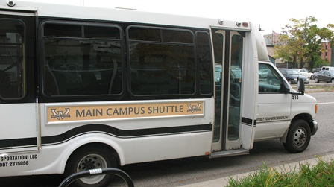
wsu shuttle

Slide 6
1.2: Project purpose
Increase usage to students with new ETA functionality & to better inform people on when the shuttle will be arriving .

Slide 7
1.2 Project scope
Includes using GPS data to calculate an estimated time to each stop along route. We will need to modify website and add back-end functions to handle ETA estimation using given API.

Slide 8
1.2 Project objective
Add ETA estimations to campusmap.wayne.edu to increase value of current application by letting users know when to expect the shuttle; not just its current location.
Create Web API and incorporate into the WSU app.

Slide 9
1.3: Team Organization
Kyle Andrews: DBA/Web Developer/Unix Admin/Researcher – researches background and the best route to take to complete the task.
Syed Hyder: Database/Presentation Developer/Observer-raises questions, finds bugs, and takes notes during presentations to better the group performance.
Mathew Jackovich: Back-end/HTML/Presenter/Meeting Coordinator – Finds the best time to meet for the group and communicates with the client.
Mohammed Kassem: Software and Web Developer/ Front-end/Boss(three weeks) – Problem resolver between the group and decision maker.

Slide 10
1.4: problem resolution policies
Weekly group meetings which consists of evaluation on each member of the group from all members then adjustments are made by the Lead.
Positive and negative feedback from all team members.
Lead has the power to veto any decisions. If member does not like the current job assigned, we can have a vote to exchange duties with another member.
Otherwise, the member is stuck with the current task.

Slide 11
1.4: problem resolution policies (cont.)
Lead makes sure that all deadlines are being met properly and are in time. Lead settles any issues/dispute within the group and has the final say in all matters.
Weekly meetings with the lead where the lead assigns the weekly duties to each member of the group.
Lead has a 3 week term unless re-voted back into lead for additional terms.

Slide 12


